Slide 1
AWS Guard Duty Azure Security Center
AWS Guard Duty & Azure Security Center
Orhen Hasday
Jul-21

Slide 2
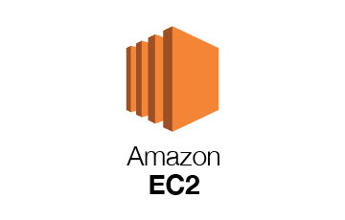
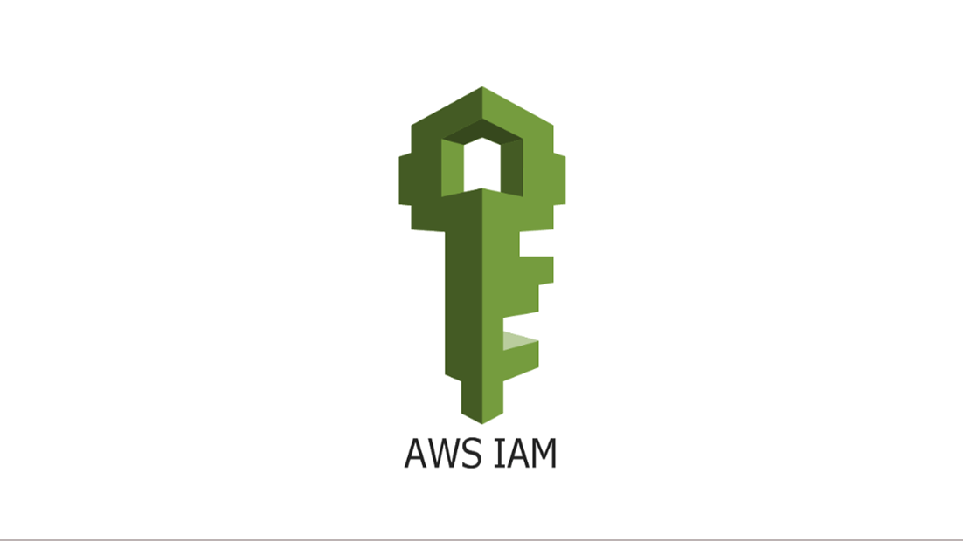
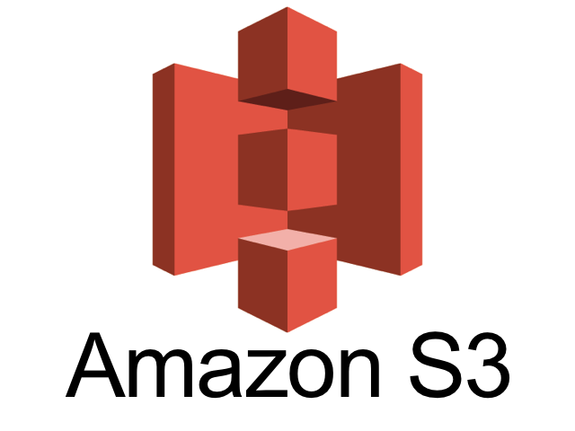
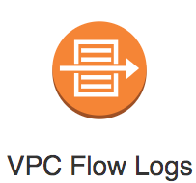
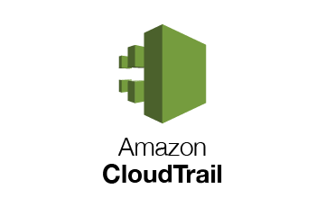
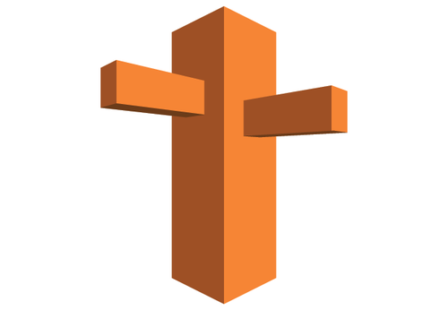
AWS Guard Duty
AWS DNS logs
https://docs.aws.amazon.com/guardduty/latest/ug/guardduty_data-sources.html

Slide 3
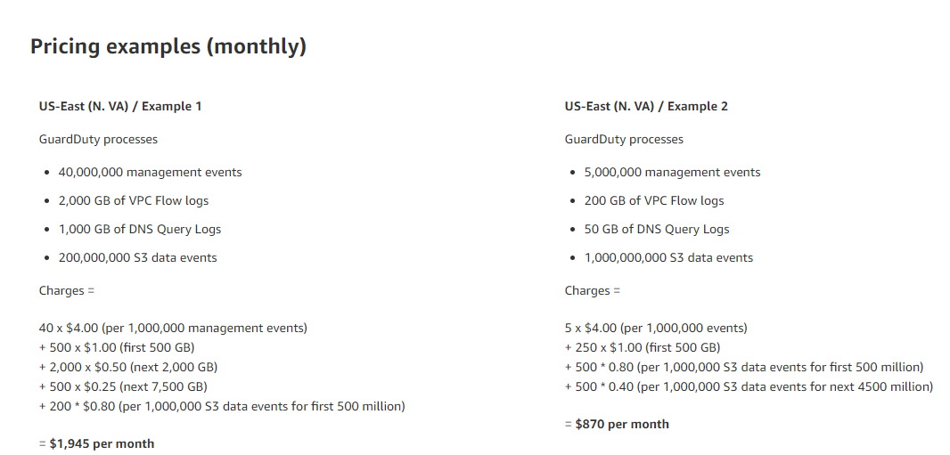
AWS Guard Duty (cost)

Slide 4
AWS Guard Duty AWS Security Hub Azure Defender Azure Security Center

Slide 5
Cloud-native (adj.) - applications built on an elastic, microservices-based architecture and managed via agile DevOps processes.
© 2019 by The Enterprise Strategy Group, Inc.

Slide 6



Challenges Securing Cloud Native Applications
© 2019 by The Enterprise Strategy Group, Inc.

Slide 7
TOP CHALLENGES
The People, Process, and Technology Concerns of Securing Cloud-native Apps
Maintaining security consistency across our own data center and
43%
public cloud environments where our cloud-native applications…
Use of multiple cybersecurity controls increases cost and
complexity
Lack of understanding of the threat types, and attack vectors and methods specific to our cloud-native applications
Our application development and DevOps teams do not involve our cybersecurity team due to fear of being slowed down
Lack of visibility into the activity of the infrastructure hosting our
cloud-native applications
Meeting prescribed best practices for the configuration of cloud-
resident workloads and the use of cloud APIs
Our existing security tools do not support cloud native
environments
35%
35%
33%
33%
30%
26%
© 2019 by The Enterprise Strategy Group, In_{W}c.
e have not experienced any challenges

Slide 8

Don’t know,
Docker host _{Other, 1%} ^{2%}
layer, 6%
Orchestration platform, 9%
Serverless cloud functions, 29%
Less Control, More Concern The elements of cloud-native Apps of most concern
Application containers, 15%
Application code, 15%
Cloud service provider, 23%
© 2019 by The Enterprise Strategy Group, Inc.

Slide 9

Aligning the implementation architecture of a container security control with our intended container deployment model
We need to verify images stored in a container registry meet our security and compliance requirements to be trusted for
production
Our current server workload security solution does not support or offer thesame functionality for containers, requiring that we
use a separate container security solution adding cost and…
The potential for container sprawl could result in poorly managed containers leaving our production environment(s)
vulnerable
The speed at which containers are built and deployed results in security controls not being included from the outset
32%
32%
29%
28%
Container Security
In addition to
process and technology, alignment with deployment plans is a top security concern
27%
There is a lack of mature cybersecuritysolutions for containers
26%
Portability makes containers more susceptible to “in motion”
compromises
26%
Automating the integration of container security controls via
our container orchestration platform
26%
An infected container can cross-contaminate other containers
22%
© 2019 by The Enterprise Strategy Group, Inc.

Slide 10

Very concerned Somewhat concerned
Not concerned
Exploits that take advantage of known…
54%
38%
9%
Targeted penetration attacks
49%
42%
9%
Exploits that take advantage of known…
49%
40%
10%
Malware
48%
44%
8%
Top-of-Mind Attack Types Run the Gamut
The misuse of a privileged accounts,…
46%
43%
12%
Attacks that results in the loss of data…
45%
47%
8%
“Zero day” exploits that take…
44%
45%
11%
Mis-configured cloud services,…
43%
47%
11%
Ransomware
43%
46%
12%
The misuse of a privileged account by…
43%
40%
17%
0%
20%
40%
60%
80%
100%
© 2019 by The Enterprise Strategy Group, Inc.

Slide 11

Implementing a Secure DevOps (“DevSecOps”) Program
© 2019 by The Enterprise Strategy Group, Inc.

Slide 12
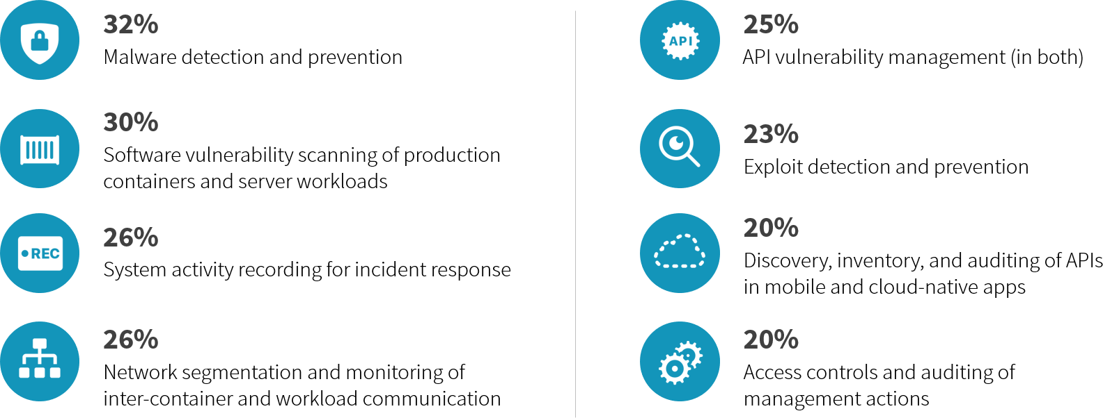

Top Runtime DevSecOps Use Cases

Slide 13
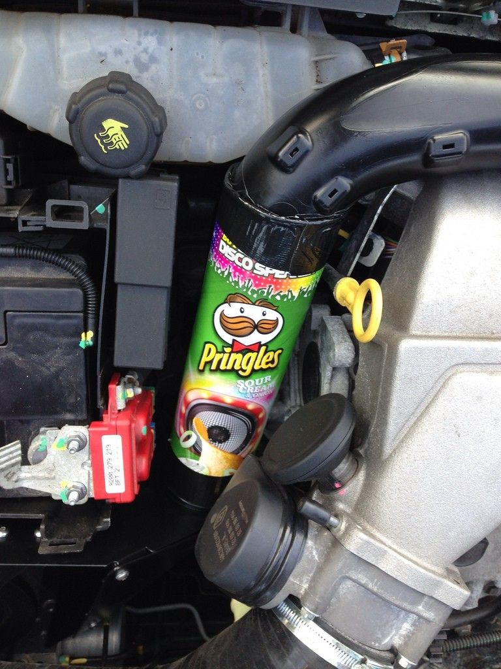
Sample Secure DevOps Use Cases
Agile User Stories by Environment
DEV - SDLC integrated AppSec
Composition analysis
Static code analysis
TEST - Reduce attack surface at build-time
Eliminate known vulnerabilities
Harden configurations of workloads and services
PROD - Policy-based runtime controls
Least privilege, anti-threat, anomaly detection, auditing
Policy by tag, and thus templates, for consistency

Slide 14

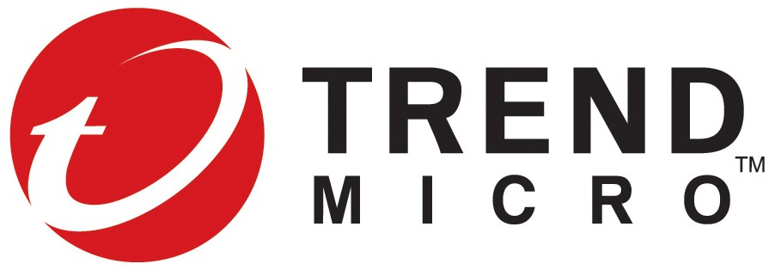

Securing cloud- native apps is a team sport.
© 2019 by The Enterprise Strategy Group, Inc.
23 Copyright 2018 Trend Micro Inc.

Slide 15

Security Across the Cloud Native Continuum

Slide 16

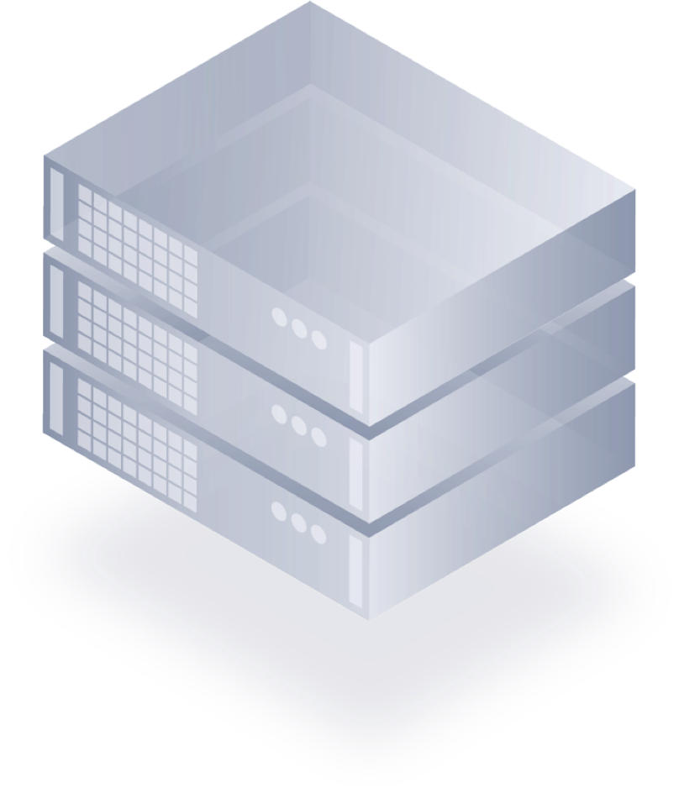
Virtual Machines
Greatest levels of isolation, compatibility and control
Full control of the OS, full control of the platform
Can be operated in stateful or stateless fashion
Suitable (but not always optimized) for any type of workload

Slide 17

Containers
Increased agility, with decreased control
User still responsible for underlying infrastructure - but you lose the OS control of VMs
Can be complex due to broad configurability
Control can be shared between Developers and traditional operations

Slide 18
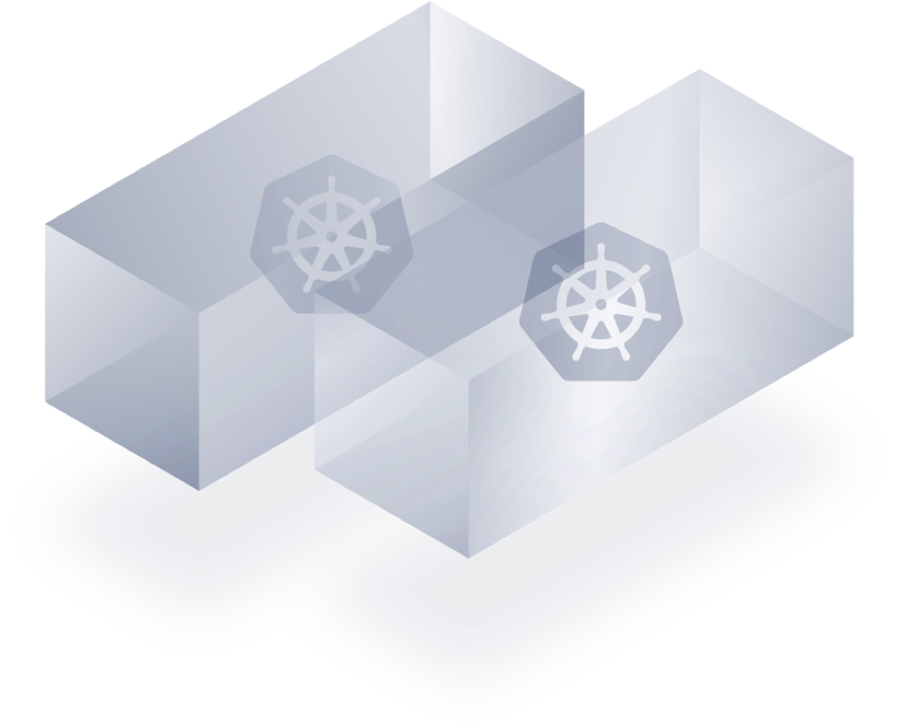
Containers-as-a-Service
Less control than containers with roll-your- own orchestration, but simpler to operate
More platform lock-in vs. containers or VMs
CaaS bundles runtime, management and orchestration - along with small levels of host control
Developer led infrastructure

Slide 19
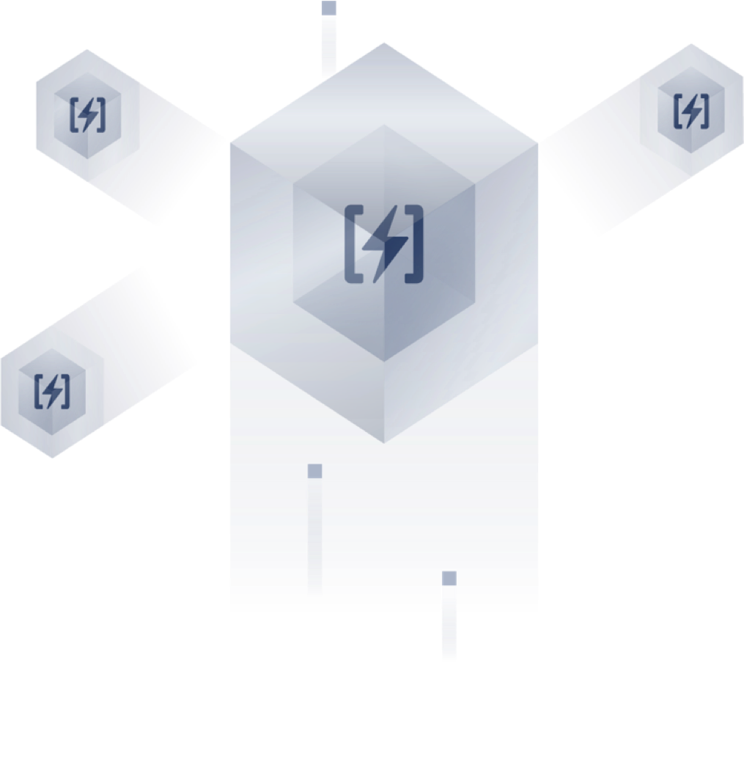
Serverless
The simplest, most agile technology on the continuum
No control (or often visibility) into the underlying host environment
Devs just build - push functions to the platform
Optimized for on-demand, highly scalable tasks

Slide 20


New World Security
Shift security left – modeling integrated into CI/CD
Policy custom tailored for each application, each build
Security that automatically scales with the environment
20

Slide 21
Key Capabilities
Cloud Security Posture Management
Cloud Workload Protection
Container Security and Kubernetes Security
Web Application and API Security
Cloud Network Security
Scan Infrastructure as Code
Scan Container Images in CI/CD
21

Slide 22
Key Capabilities
AWS Guard Duty
AWS Security Hub
Azure Defender
Azure Security Center
22

Slide 23
AWS GuardDuty
Amazon GuardDuty is a threat detection service that continuously monitors for malicious activity and unauthorized behavior to protect your AWS accounts, workloads, and data stored in Amazon S3. With the cloud, the collection and aggregation of account and network activities is simplified, but it can be time consuming for security teams to continuously analyze event log data for potential threats. With GuardDuty, you now have an intelligent and cost-effective option for continuous threat detection in AWS. The service uses machine learning, anomaly detection, and integrated threat intelligence to identify and prioritize potential threats. GuardDuty analyzes tens of billions of events across multiple AWS data sources, such as AWS CloudTrail event logs, Amazon VPC Flow Logs, and DNS logs. With a few clicks in the AWS Management Console, GuardDuty can be enabled with no software or hardware to deploy or maintain. By integrating with Amazon CloudWatch Events, GuardDuty alerts are actionable, easy to aggregate across multiple accounts, and straightforward to push into existing event management and workflow systems.
23

Slide 24
Azure Security Center
https://query.prod.cms.rt.microsoft.com/cms/api/am/binary/RE4s2L2

